Slide 1


Selective Jamming Attacks in Wireless Networks
Alejandro Proaño - Loukas Lazos
Dept. of Electrical and Computer Engineering
University of Arizona

Slide 2
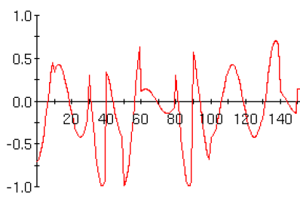
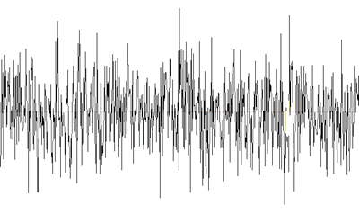
Jamming Attacks in Wireless Communications
Open nature of wireless medium leaves it exposed to jamming
Jamming: Deliberate interference with radio transmissions in order to corrupt signal beyond recovery
f
f_{c}
A
B
f
Jammer
f_{c}

Slide 3
Typical Adversary Model – External Attacker
A digitally modulated symbol cannot be recovered at the receiver if
Adversary injects signals of arbitrary length and at any time (e.g., noise modulated FM, noise bursts, or continuous wave (CW) tones)
From physical layer point of view
  Adversary attempts to drop SNJR below threshold
ICC 2010: Alejandro Proano, and Loukas Lazos

Slide 4
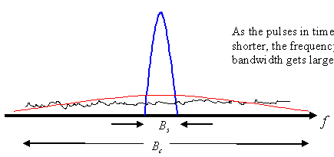
Common Anti-Jamming Techniques
Spread spectrum (SS) communications
  Not all wireless systems are allocated enough bandwidth for spreading
  Suitable for voice communications
  Jamming still possible given sufficient power
  Success relies on the secrecy of PN sequences
SS prevents jamming as long as the PN sequence is kept secret
ICC 2010: Alejandro Proano, and Loukas Lazos

Slide 5
Our Adversary Model – Inside Jammer
Adversary’s Goal:
Launch a Denial-of-Service (DoS) attack
Stealthiness – Jammer tries to remain undetected
Adversary is an insider
  Has access to commonly shared cryptographic secrets (e.g., PN sequences)
  Is aware of the protocol specificities
  Is aware of the network topology
  May be equipped with advanced hardware – Multiple radios, Directional antennas, High computational power
Selectively target messages of high importance
Requires packet classification
ICC 2010: Alejandro Proano, and Loukas Lazos

Slide 6
Why is this Model Realistic?
Unattended nodes lack physical security
Broadcast transmissions require shared PN sequences
A
RREP
B
min cut
Selectively target messages of high importance
Requires packet classification
ICC 2010: Alejandro Proano, and Loukas Lazos

Slide 7
Selective Jamming Attacks
Based on real-time packet classification
Based on protocol semantics ([Brown et. al. 2006])
hdr
payload
A
B
RTS
A
CTS
B
Anticipated
message
Anticipated message

Slide 8
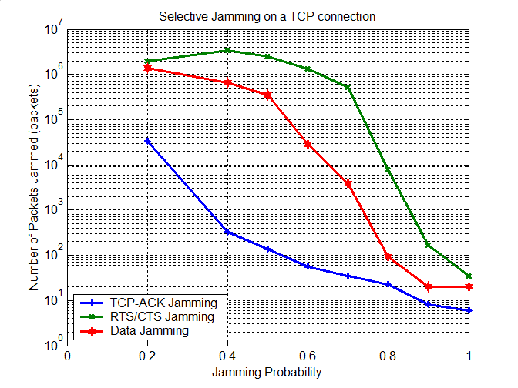
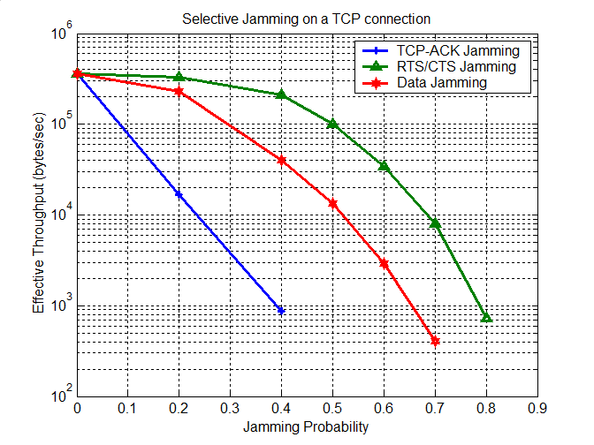
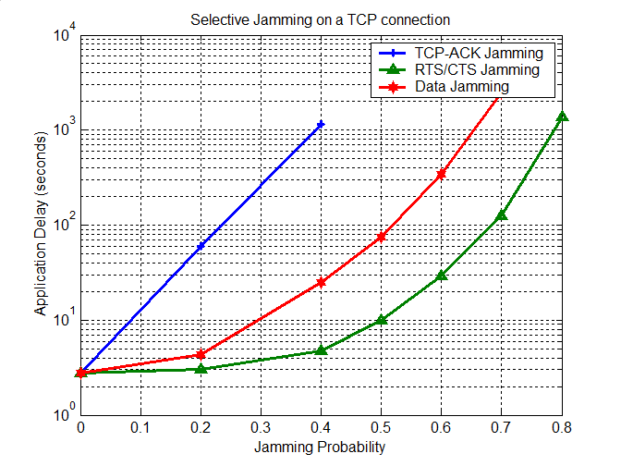
Impact of Selective Jamming Attacks

Slide 9
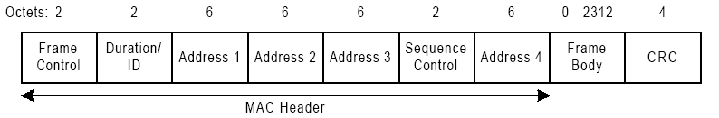
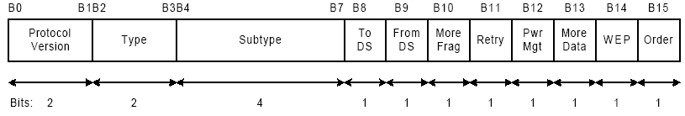
Selective Jamming - Real-time Packet Classification
Decode Received Symbol
NO
Packet
Classified?
YES
Selective Jamming
ICC 2010: Alejandro Proano, and Loukas Lazos

Slide 10
Real-time Packet Classification
Problem: Can an eavesdropper decode before receiving the entire packet?
Depends on the implementation of the highlighted blocks
  Modulator defines how many bits are revealed per symbol transmitted
  Channel defines how fast we can recover encoded blocks
  Channel decoder defines how many errors we can afford
Source
Source Encoder
Channel Encoder
Interleaver
Modulator
Wireless Channel
Output
Source decoder
Channel decoder
Deinterleaver
Demodulator
ICC 2010: Alejandro Proano, and Loukas Lazos

Slide 11
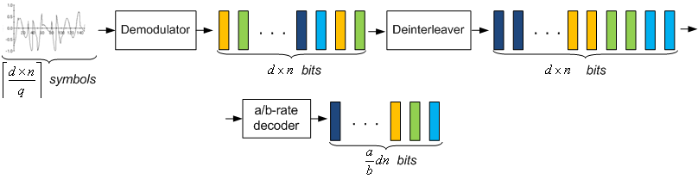
Example - Real-time Packet Classification
Assume:
Block interleaver of depth d bits that processes blocks of length n bits
a/b-rate convolutional encoder
Symbols of length q bits
To decode received data:
For 802.11a:
  24 bits per symbol at 6 Mbps, 216 bits per symbol at 54 Mbps
ICC 2010: Alejandro Proano, and Loukas Lazos

Slide 12

Prevention of Packet Classification
Packet Encryption
Key must be a shared one for broadcast operations
{
}
hdr
payload
K
B
A
ciphertext block
ciphertext block
. . .
IV
d_{K}
d_{K}
plaintext block
plaintext block
ICC 2010: Alejandro Proano, and Loukas Lazos

Slide 13
Mapping to Commitment Schemes
C
Committer
(C,d) = commit(m)
Verifier
d
m =open (C, d)
Hiding property: No information about m can be inferred until d is released.
Committer→ Sender
Verifier → Any receiver (including the jammer)
Committed value→ transmitted packet
receivers
sender
jammer
ICC 2010: Alejandro Proano, and Loukas Lazos

Slide 14
A Simple Commitment Scheme
Choose a random key K of length q; q: information bits per symbol
Committer
C = E_{K}(m||K)
d = K
C = E_{K}(m||K), MAC_{K}(m||K)
Verifier
K
m||K= D_{K}(C)
Verify MAC
Released in one symbol
Security: jammer must not be able to brute force C before the end of the transmission of K
Computational Overhead: One encryption + One hash operation
Communication Overhead: Length of hash + One symbol
ICC 2010: Alejandro Proano, and Loukas Lazos

Slide 15
A Solution Based on Cryptographic Puzzles
Cryptographic Puzzles: Create problems that are solvable within a time interval t
Asymmetry between problem generation and solution
Easy to generate, Hard to solve
Examples
  Time-lock puzzles (proposed by Rivest) – Require asymmetric crypto
  Hash-based puzzles (proposed by Juels et. al.) – parallelizable
Sender
Puzzle(m||r)
receiver
r: random nonce
ICC 2010: Alejandro Proano, and Loukas Lazos

Slide 16
A Solution Based on All-or-Nothing Transformations
All-or-nothing transformation: A publicly known and completely invertible pre-processing step to a plaintext ([Rivest 1997])
…
m₁
m₂
m₃
m_{n}
plaintext
F
bijective function
m'₁
m'₂
m'₃
m'_{n}
pseudo-text
No info on m_{i} without receiving ALL m_{i}’s
Block size is set equal to the symbol size
Examples
  Linear AONTs ([Stinson 2001]) – Unconditionally secure
  Package transform ([Rivest 1997]) – Computationally secure
ICC 2010: Alejandro Proano, and Loukas Lazos

Slide 17
Final Remarks
Addressed the problem of selective jamming attacks in wireless networks, in the presence of insider adversaries
Showed feasibility of selective jamming via real-time packet classification; Considered PHY layer implementation
Illustrated the severity of selective jamming on network performance (e.g., TCP performance)
Proposed several solutions preventing real-time classification based on
  Commitment schemes
  Cryptographic puzzles
  All-or-nothing-transformations
ICC 2010: Alejandro Proano, and Loukas Lazos

