Slide 1
IMap: Visualizing Network Activity over Internet Maps
Thienne Johnson Joseph Fowler Paolo Simonetto
Michael Schneider Carlos Acedo
Stephen Kobourov Loukas Lazos

Slide 2
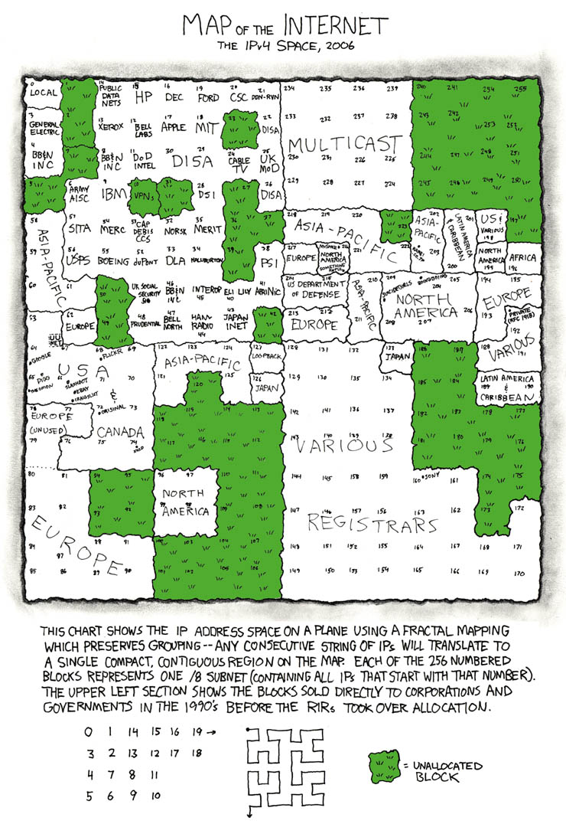
How is the Internet organized?
[xkcd, Map of the Internet
http://xkcd.com/195/]

Slide 3
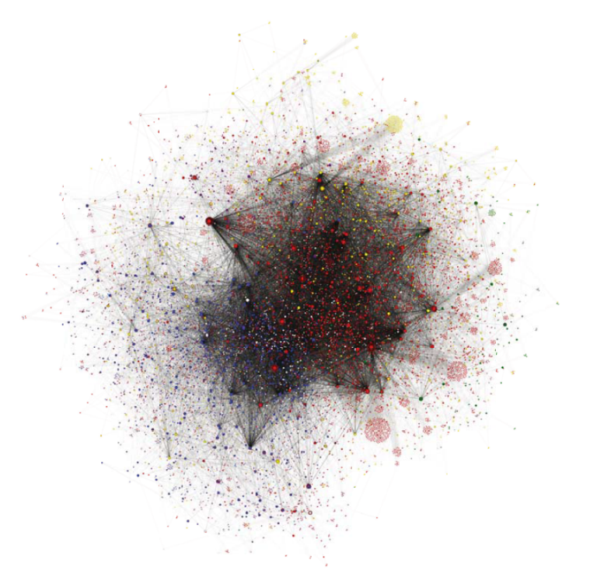
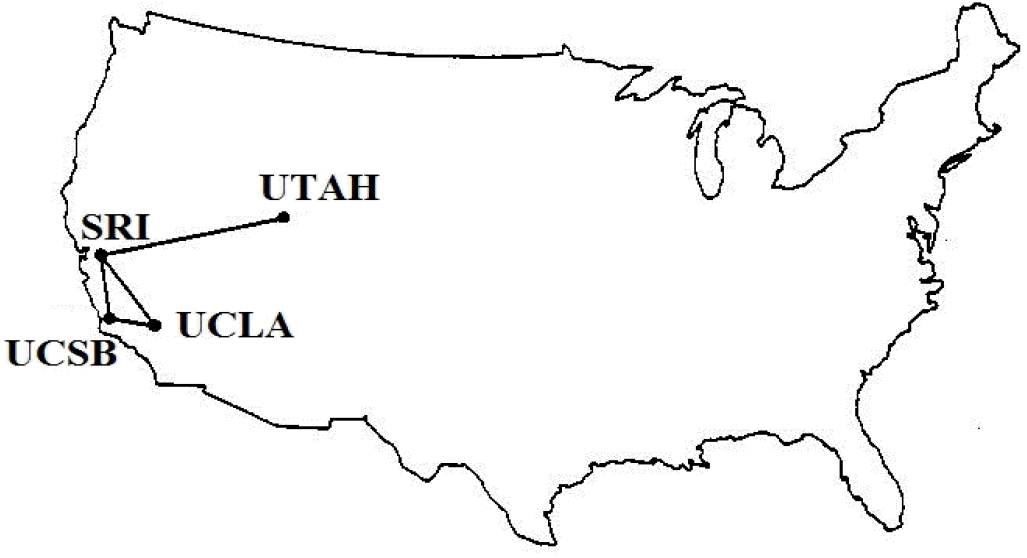
How does the Internet evolve?
How does the changing topology impact the traffic dynamics?

Slide 4
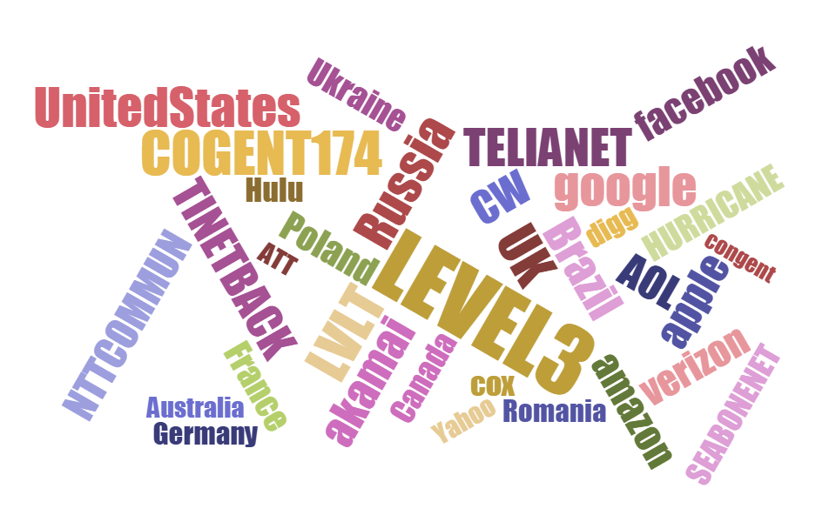
Who are the main players and how do they relate?
Does the Internet ecosystem mimic the economic and geo-political one?

Slide 5
Can we predict the impact of large-scale outages and attacks?
Can we identify distinct attack patterns?

Slide 6
Networking
Security
Visualization
Synergy between

Slide 7
Internet Visualization Attempts
[Cheswick, 1998]

Slide 8
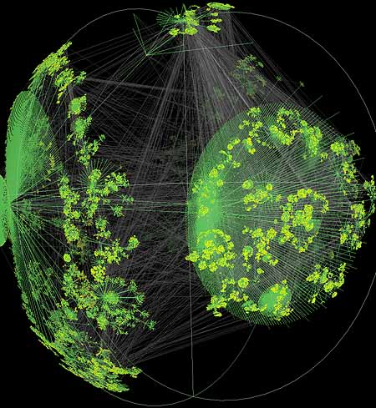
Internet Visualization Attempts
“Jelly fish”
“Hair ball”
[Walrus - Graph Visualization Tool, CAIDA, 2001]
[Boitmanis et al, 2007]

Slide 9
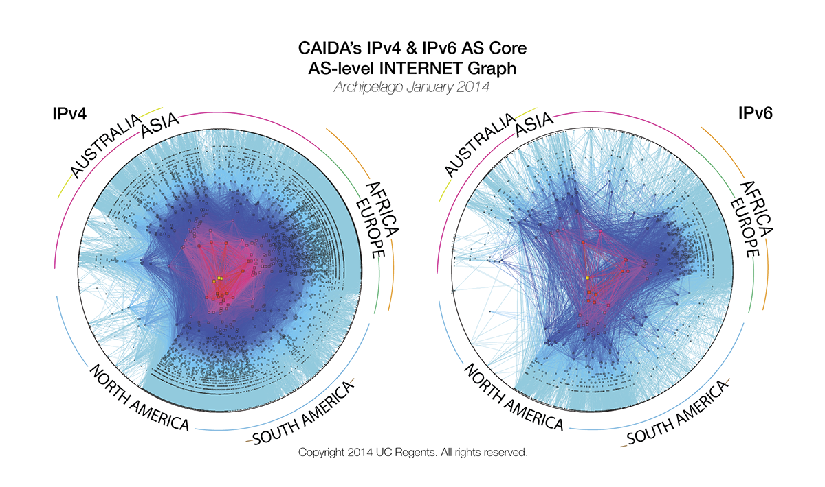
Ring Visualization of the AS Core
http://www.caida.org/research/topology/as_core_network/2014/

Slide 10
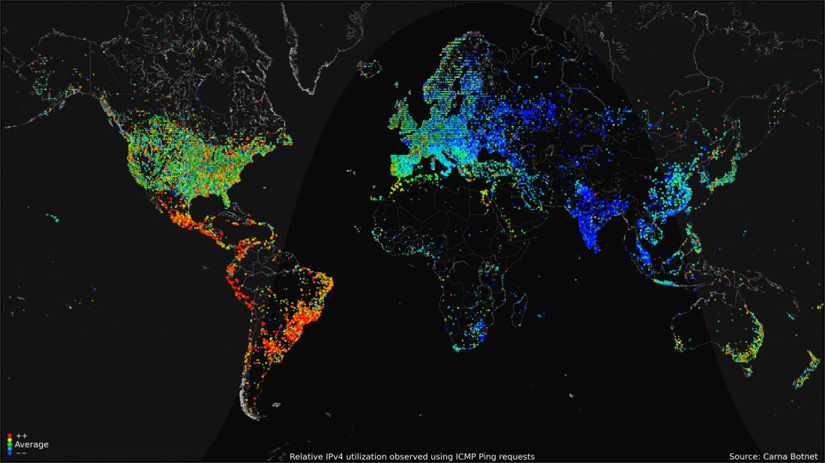
IP Space Utilization over 24 Hours
http://internetcensus2012.bitbucket.org/images/geovideo.gif

Slide 11
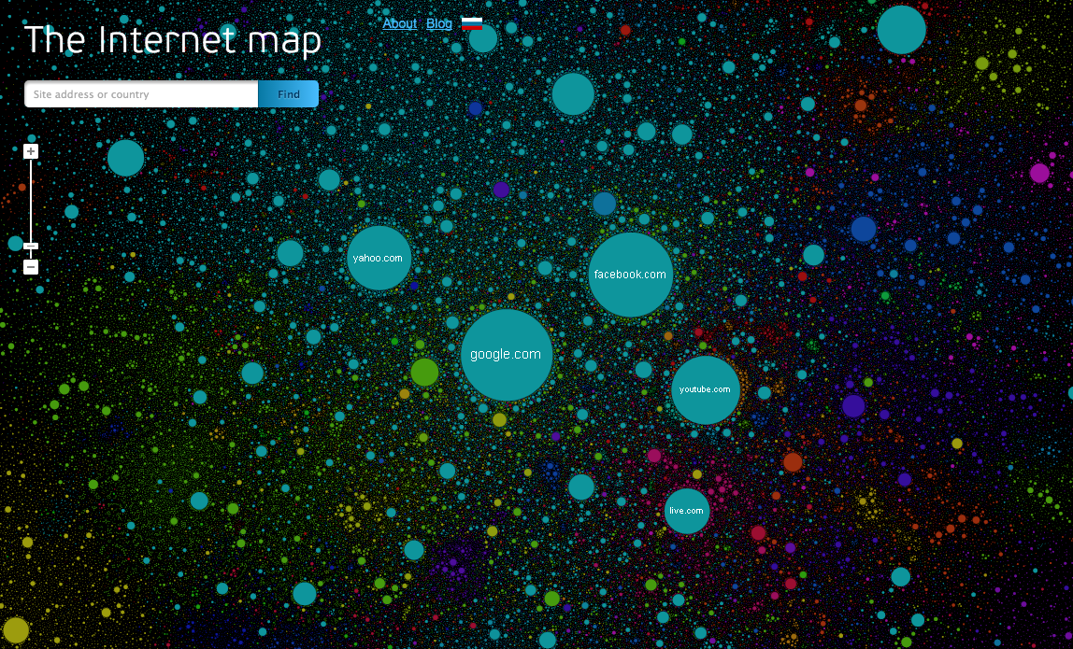
Webpage Visits - Alexa Traffic Statistics
http://internet-map.net/

Slide 12
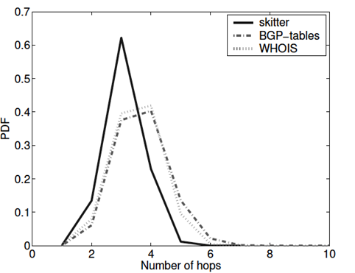
Graph Analysis of the Internet Topology
Distance distribution
[Mahadevan et al, 2006]

Slide 13
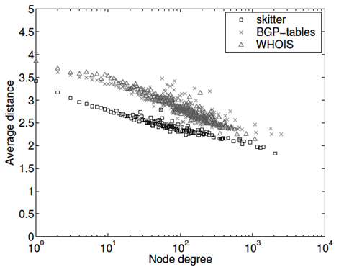
Graph Analysis of the Internet Topology
Average distance from k-degree nodes d(k)
[Mahadevan et al, 2006]

Slide 14
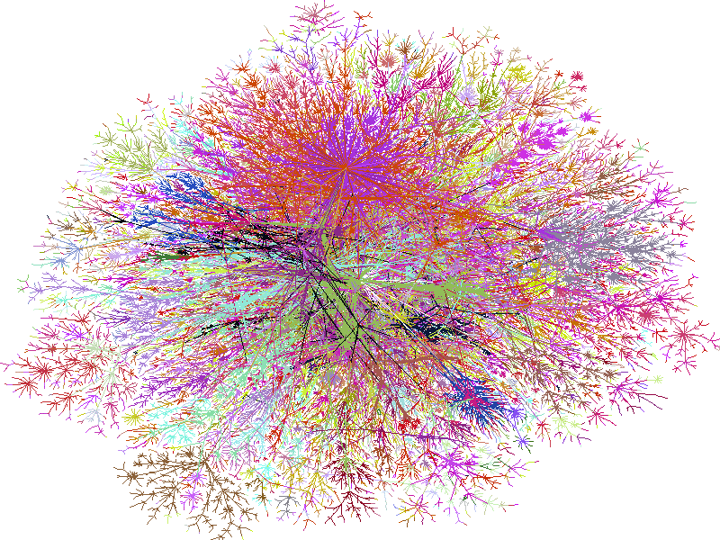
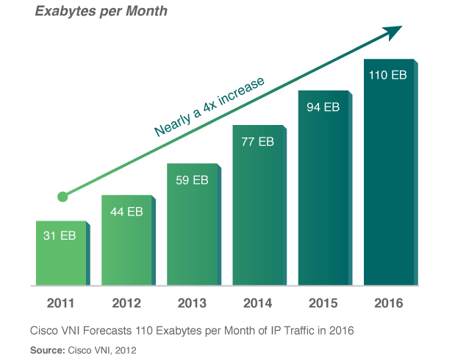
Limitations of Prior Work
Graphics are as complex as the underlying data
Pretty pictures, but not informative
Human cognitive ability is highly challenged
Analytical metrics fail to capture “local” properties
Macroscopic Internet views abstract its structure
Role of each Internet Service Provider (size, connectivity…)
Relationships between organizations, countries, allies, foes, content providers, ISPs and their dynamics
Impact of outages and topological attacks on the Internet’s resilience
Dynamic Internet data remains overwhelming
Too many data points harden early attack detection
Attack attribution remains challenging –
Internet structure is largely ignored
Attack patterns are hard to detect at very fine granularities
Notes:
Graphics are as complex as the underlying data
Pretty pictures, but not informative
Human cognitive ability is highly challenged
Analytical metrics (e.g., graph metrics) fail to capture “local” Internet properties
Macroscopic Internet views abstract its structure
Role of each Internet Service Provider (ISP) (size, connectivity, type, etc.)
Relationships between organizations, countries, allies, foes, content providers, ISPs and their dynamics
Impact of outages and topological attacks on the Internet’s resilience
Dynamic Internet data (e.g., traffic) remains overwhelming
Too many data points harden early attack detection
Attack attribution remains challenging – Internet structure is largely ignored
Attack patterns are hard to detect at very fine granularities

Slide 15
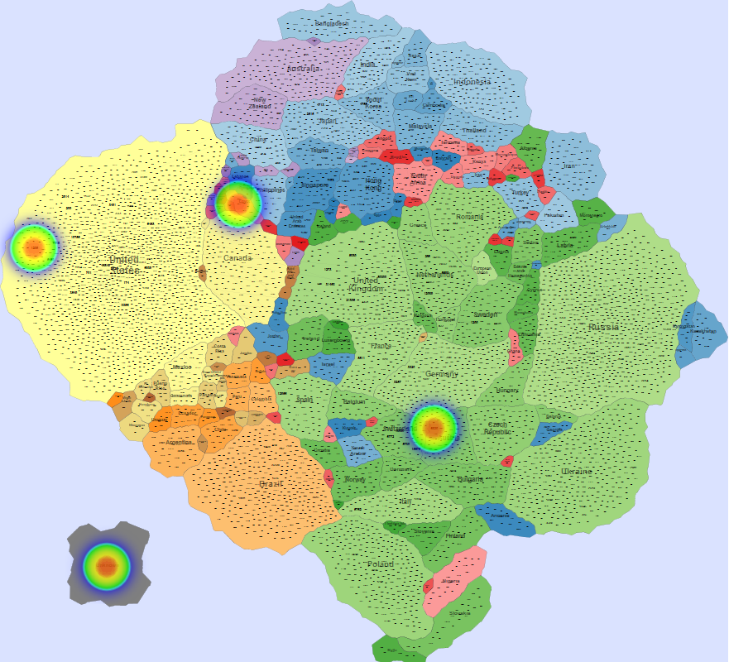
IMap

Slide 16
IMap Features
A geographic-like representation of the Internet topology via canonical maps
Contiguous regions based on topology attributes
Countries scaled based on their Internet presence
Overlays of dynamic traffic
Labels proportional to
node importance
Coloring based on
continent
Country proximity related to
connectivity “strength”

Slide 17
IMap Generation Process
Autonomous System (AS): “a connected group of one or more IP prefixes run by one or more network operators which has a SINGLE and CLEARLY DEFINED routing policy” (RFC 130).
Internet Service Provider (ISP)
Large company
University

Slide 18
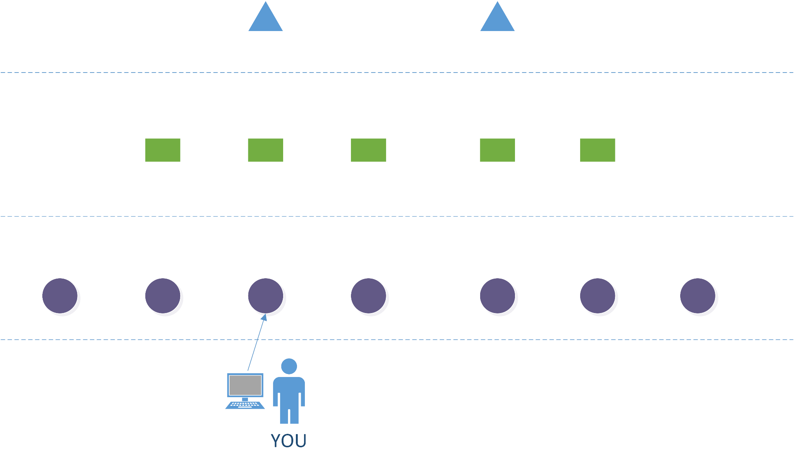
Internet Organization at the AS Level
AT&T
Transit
Cogent
Tier 1
COX
Tier 2
Transit
Transit
UofA
Tier 3
Stub
Multi-homed
Peer-to-peer (p2p)
Customer-to-provider (c2p)

Slide 19
BGP (Border Gateway Protocol) Paths and Routing Policies
“I can reach prefix 168.35/16 via AS_{i}, AS_{j}, and AS_{k}”
Tier 1
BGP
Tier 2
BGP
BGP
Tier 3
Data flow to 168.35.65.24
Peer-to-peer (p2p)
Customer-to-provider (c2p)

Slide 20
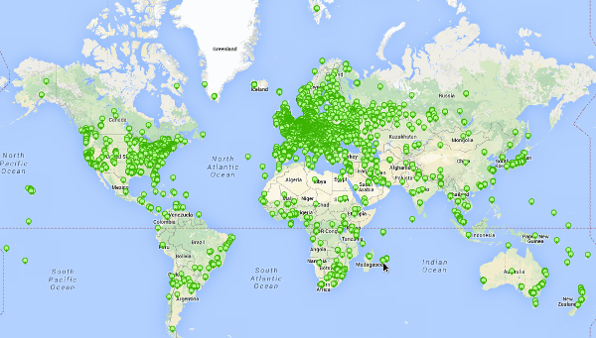
Data Collection
BGP monitors deployed around the world
RIPE-RIS, RouteViews, Looking Glasses…
RIPE: 6675 probes
https://atlas.ripe.net/about/
Topology data is incomplete – 60% of registered ASes are detected
Organizations hide many paths (no BGP advertisements)
Monitors receive a limited number of advertisements
AS relationship inference and validation is a hard and largely unsolved problem

Slide 21
Inferring the AS Graph
BGP routing advertisements
AS graph G(V, E),
V: AS set
E: AS relationships
IP_Prefix, AS₁ → AS₂ →AS₃ → AS_{n}
150.15.44.0, 33 →1433 →7018 →2322
79.1.23.0, 876 → 4553
16.23.0, 6 → 1 → 1433
144.98.42.0, 33 → 4533 → 876
…
…
1
7018
6
1433
2322
4533
33
16
876

Slide 22
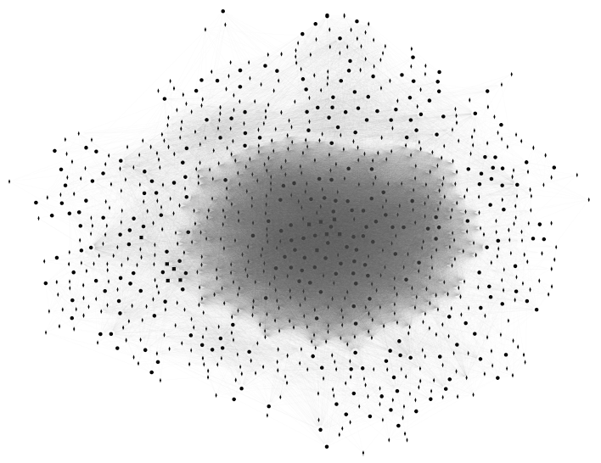
Resulting AS Graph

Slide 23
Weighted Graph Construction – Node weights
Node weights assigned relative to the AS importance
Customer Cone of AS_{i}: Set of ASes that are customers (direct or indirect) of AS_{i} (p2p links are excluded)
Node weight
(a) Number of ASes in the customer cone of AS_{i}
(b) IP space size served by AS_{i}
Customer to provider (c2p) relationships
AS_{a}
Customer Cone
for AS_{b}
AS_{a}
Customer Cone
for AS_{a}
AS_{b}
AS_{c}
AS_{b}
AS_{c}
Customer Cone
for AS_{c}
AS_{d}
AS_{e}
AS_{f}
AS_{d}
AS_{e}
AS_{f}
[Luckie et al., 2013]

Slide 24
Weighted Graph Construction – Link Weights
Link weights assigned relative to the link importance
(a) Common size of customer cone served by the link
(b) Number of BGP paths advertising an AS link
Customer Cone
for AS_{b}
{AS_{d}, AS_{e}, AS_{f}}
AS_{b}
AS_{c}
Customer Cone
for AS_{c}
AS_{d}
AS_{e}
AS_{f}

Slide 25
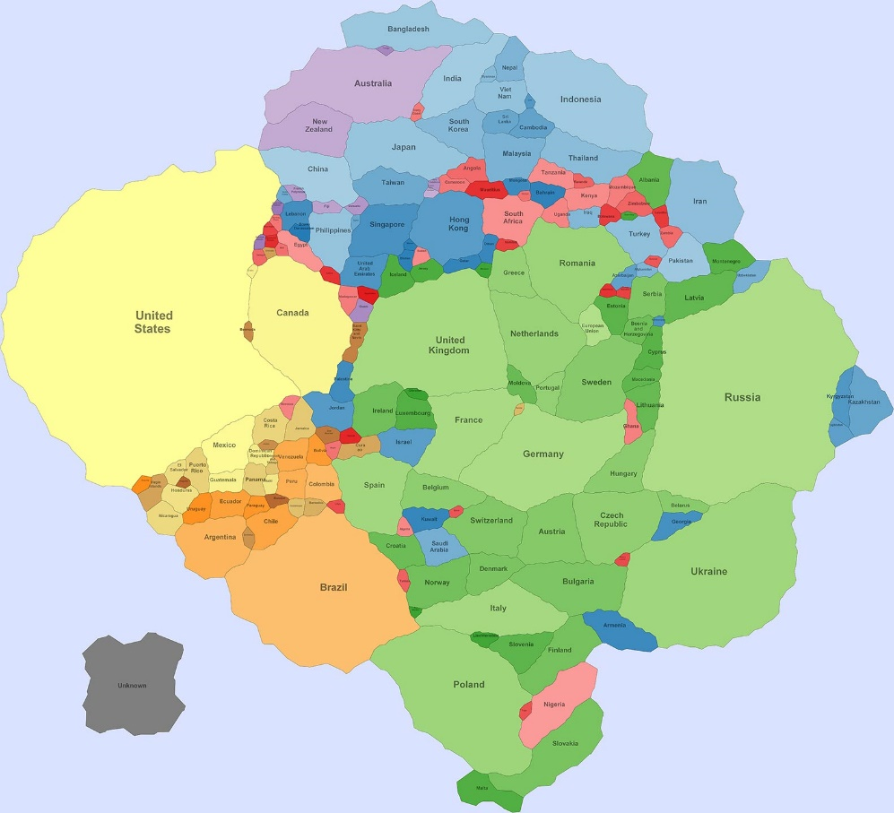
From an AS Graph Topology to an IMap…
How?

Slide 26
Map Generation Process Flow
Five-step process of going from a random graph layout to an IMap

Slide 27
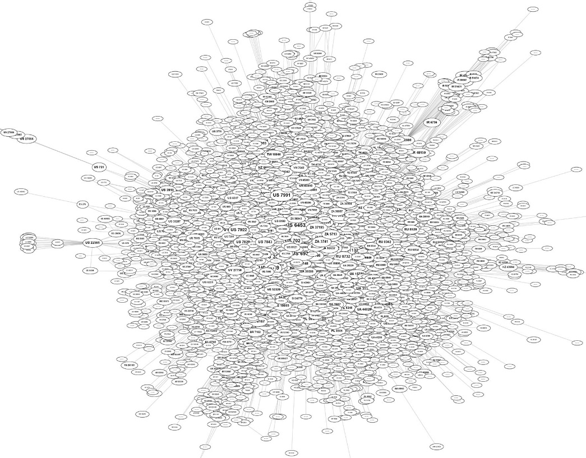
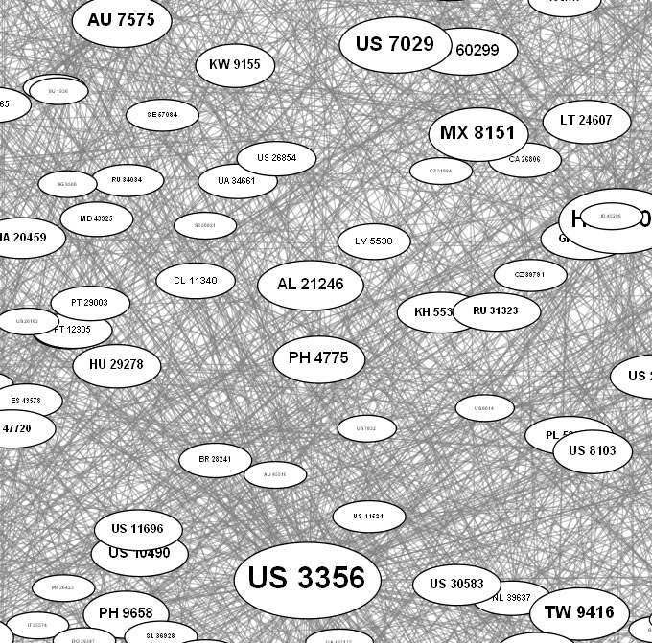
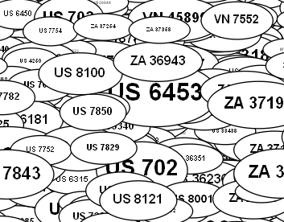
Step 1 – Apply Force-Directed Layout
Force-directed layout models physical forces
US 3356
US 7029
US 7029
US 3356
Disconnected nodes are repelled ← →
Connected nodes are attracted →←
PH 2775
PH 2775
Attraction strength based upon edge weight
Layout
Graph
Node labels are 2-letter country code and AS number
Nodes sizes
proportional to node weights

Slide 28
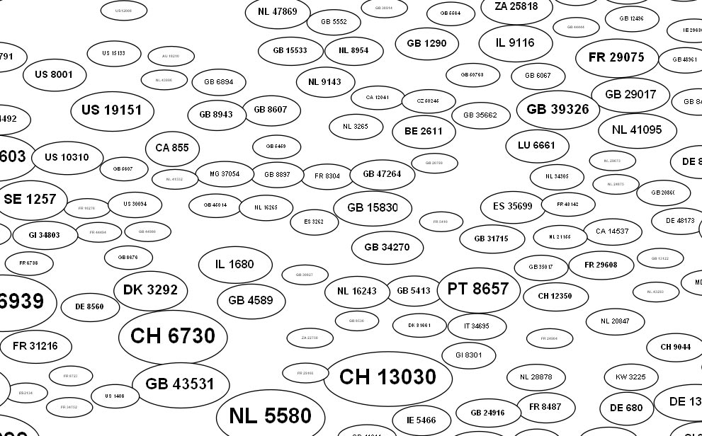
Step 2 – Remove Overlaps
US 3356
US 3356
US 7029
US 7029
PH 2775
PH 2775
Spread out nodes while keeping relative proximities
Remove
Overlaps
Overlapping nodes
Cannot read labels!
Hide edges since node positions now fixed

Slide 29
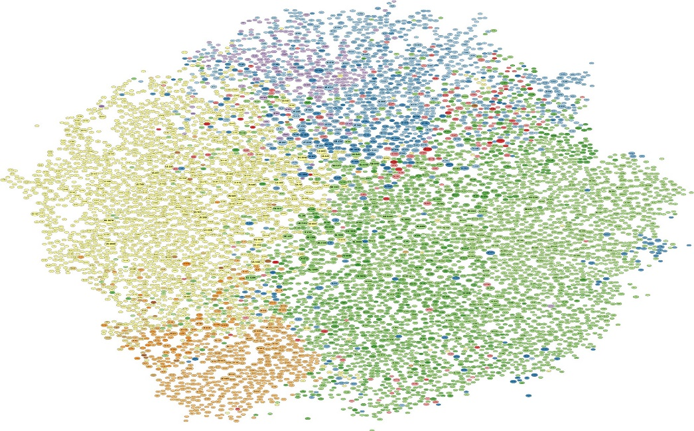
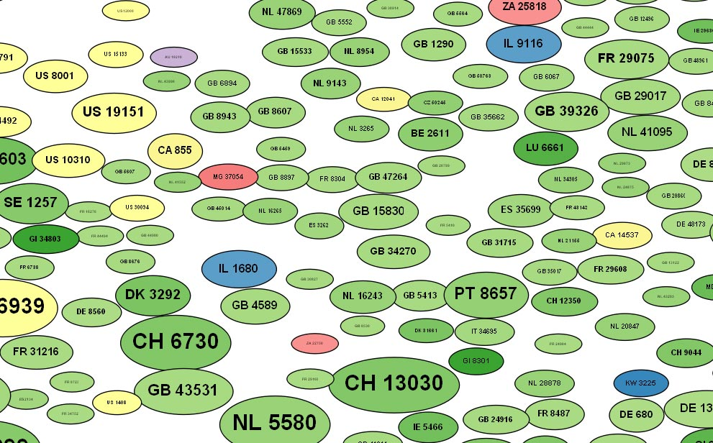
Step 3 – Color Nodes by Continent
North America
Nodes colored by continent and shaded from largest to smallest country so that,
for instance, US nodes are colored yellow
South America
Europe
Asia
Africa
Oceania
Color
Nodes

Slide 30
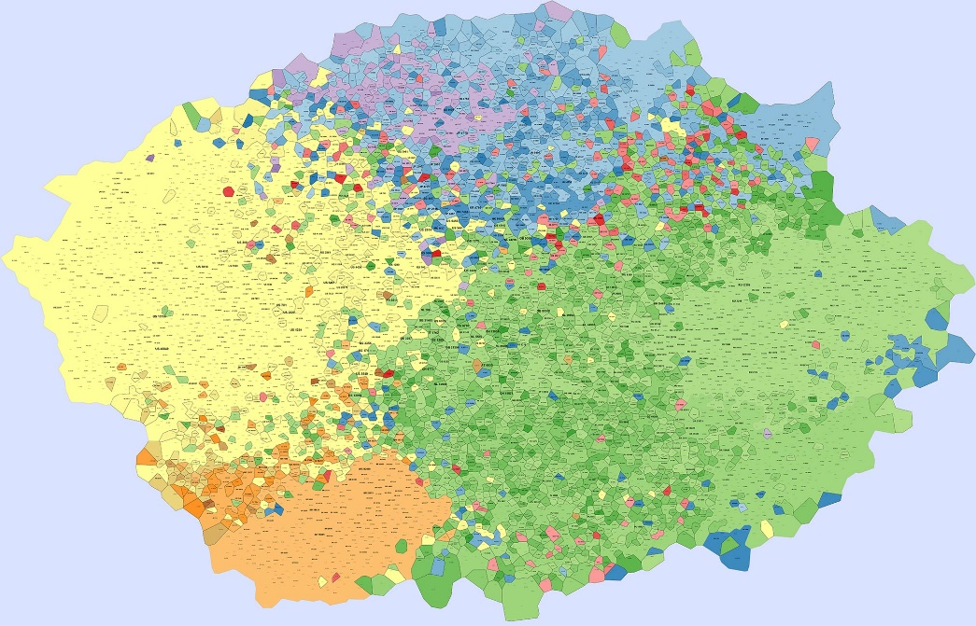
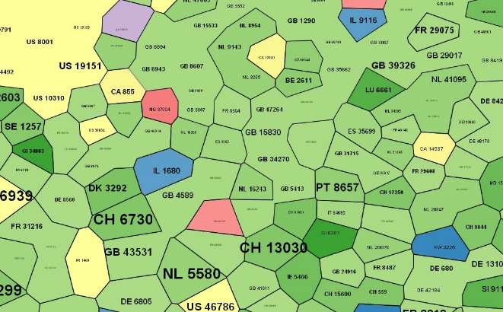
Step 4 – “Expand” Nodes to Fill in Gaps
Notice that US nodes colored yellow
remain in approximately same area
Color surrounding region with ocean color
Expand
Nodes
Fill area with closest color
Lots of white area!
Have boundaries between colors

Slide 31
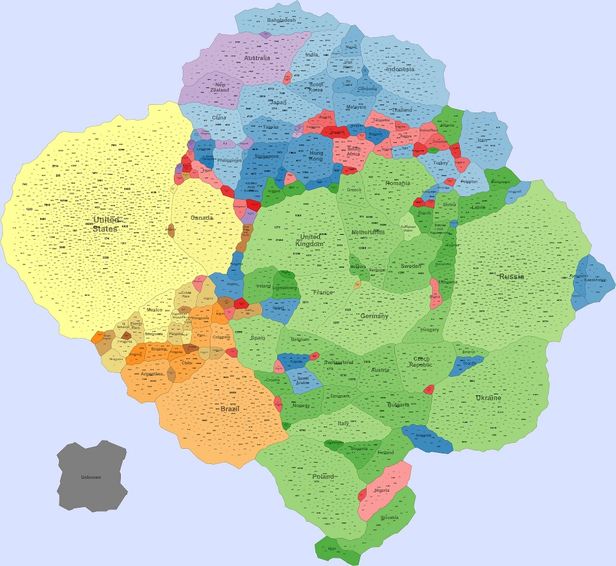
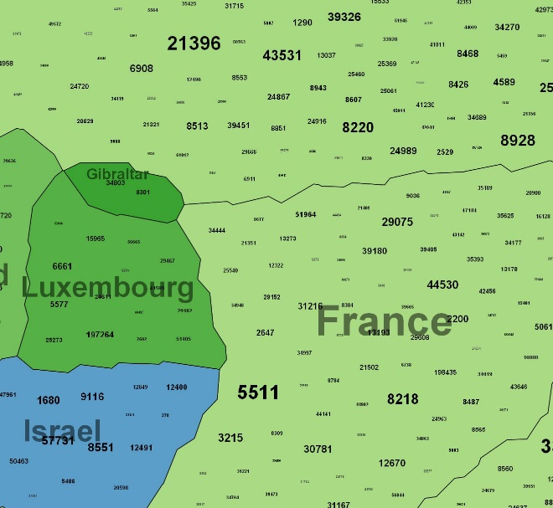
Step 5 – Form Contiguous Countries
Group country nodes into contiguous regions while trying to stay close to original positions
Reposition
Nodes
Include “Unknown” country for ASes of
DarkNet and of unknown origin
CH country not connected!

Slide 32
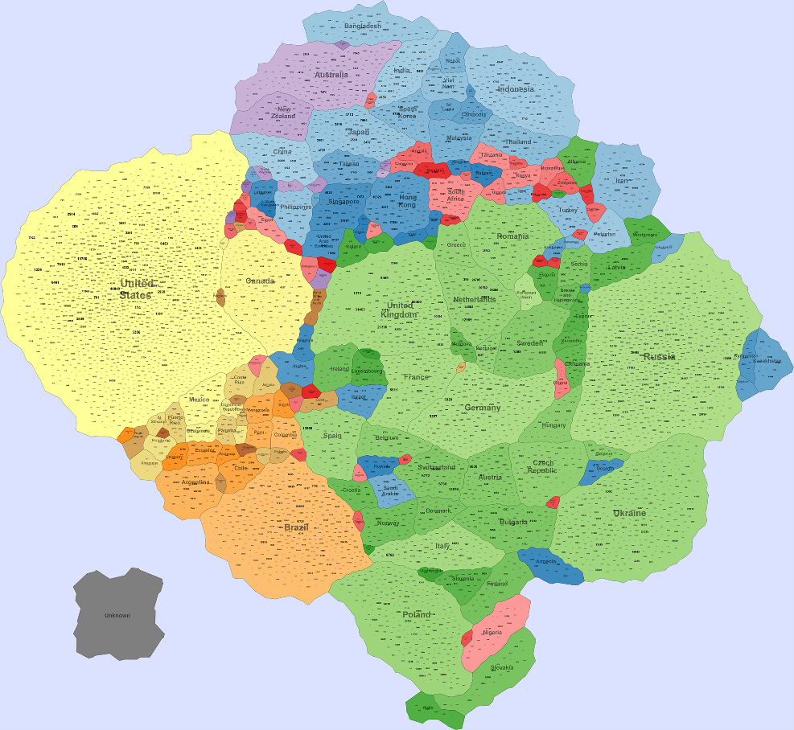
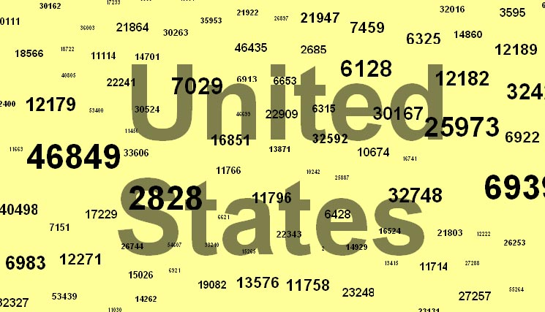
More IMap Features
Country sizes dependent on the number of AS nodes
North America
Nodes sizes logarithmically proportional to node weights
AS 46849 has 27534 ASes in AS customer cone with 24 pt font
AS 32748 has 145 ASes in AS customer cone with 13 pt font
South America
Europe
Asia
Africa
Oceania
AS nodes are grouped by geographic countries but can be grouped by AS organizations or by more natural clusters

Slide 33
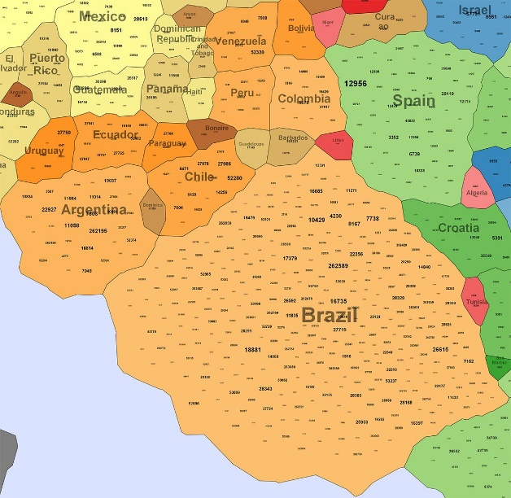
More IMap Features
Our “Internet Pangea” differs from physical geography map
both in area and in distance
Argentina larger than Mexico
Spain and Brazil adjacent
North America
South America
Europe
Asia
Africa
Oceania
Countries of the same continent tend to be
grouped together
Countries adjacencies dependent upon number of AS connections
E.g., all South American countries close to Brazil

Slide 34
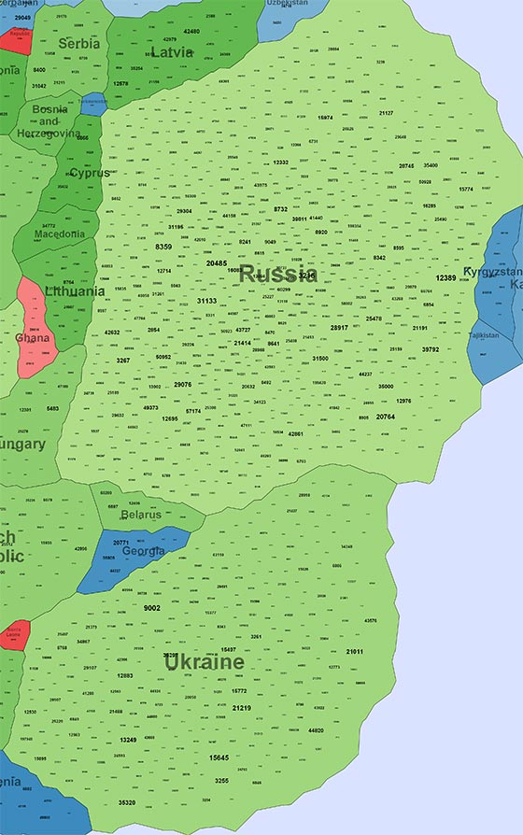
Correlation Between Number of AS Nodes and Area
808 Nodes
12% of Nodes
9% of Area
240 Nodes
5% of Nodes
5% of Area
Ten countries with most ASes

Slide 35
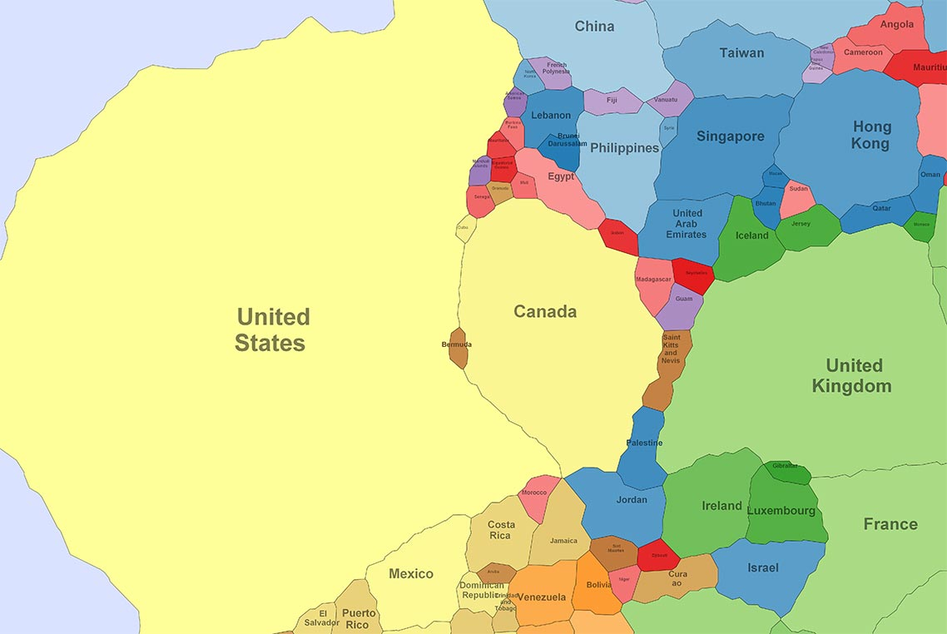
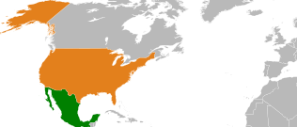
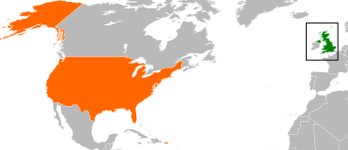
Correlation Between Pairwise Distances
Correlations twice as strong for 20 pairs of the largest countries than for all countries

Slide 36
Correlation Between Distances and Edge Counts
Correlations 5 times as strong for the 5 pairs of largest countries than for all countries
Edge counts for country pairs:
US to Canada → 367
US to UK → 491
US to France → 137
UK to France → 178
UK to Canada → 90
UK to France → 45
Higher edge counts correspond to closer country pairs!

Slide 37
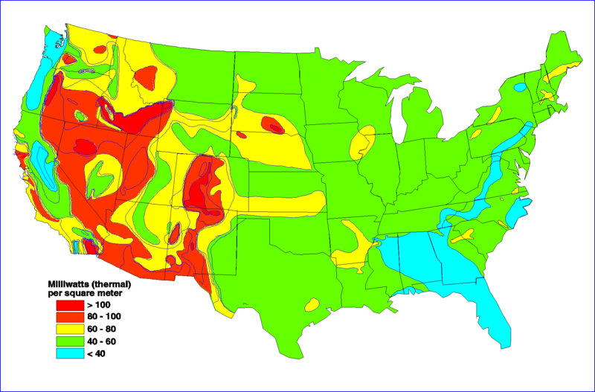
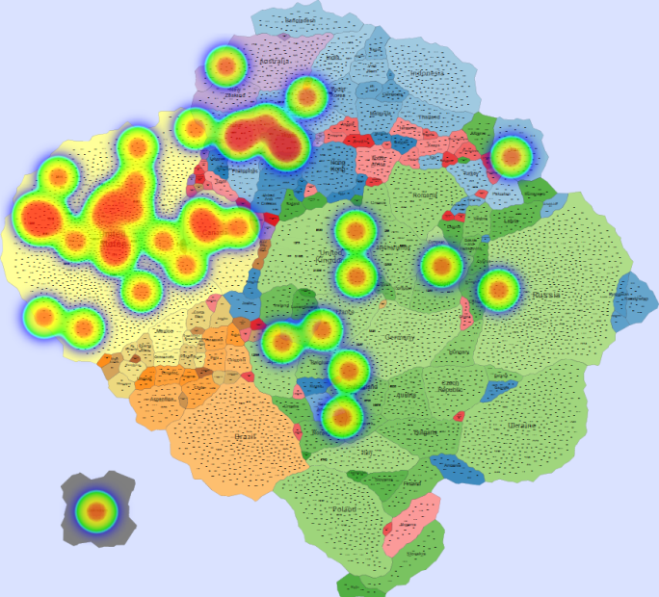
Heatmaps – Displaying Dynamic Data
http://commons.wikimedia.org/wiki/File:Geothermal_heat_map_US.png
A common example of a heatmap overlay
Overlays from an IDS aggregated at the AS level
Network traffic statistics
Network events
Global internet events

Slide 38
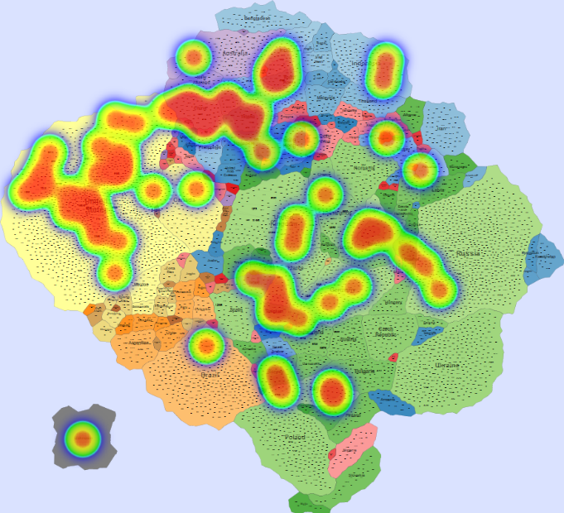
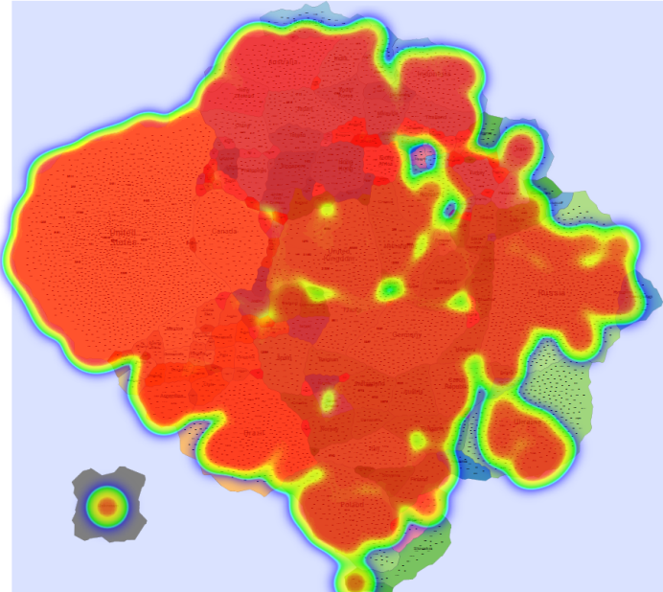
Code-Red Worm Propagation
In July 19th, 2001, a variant of the Code-Red worm appeared and spread very rapidly around the world in 31 hours of activity.
Minute 1 10th hour 17th hour (peak)
Time
CAIDA video
IMap Video
[CAIDA. Dataset on the code-red worms, 2001]

Slide 39
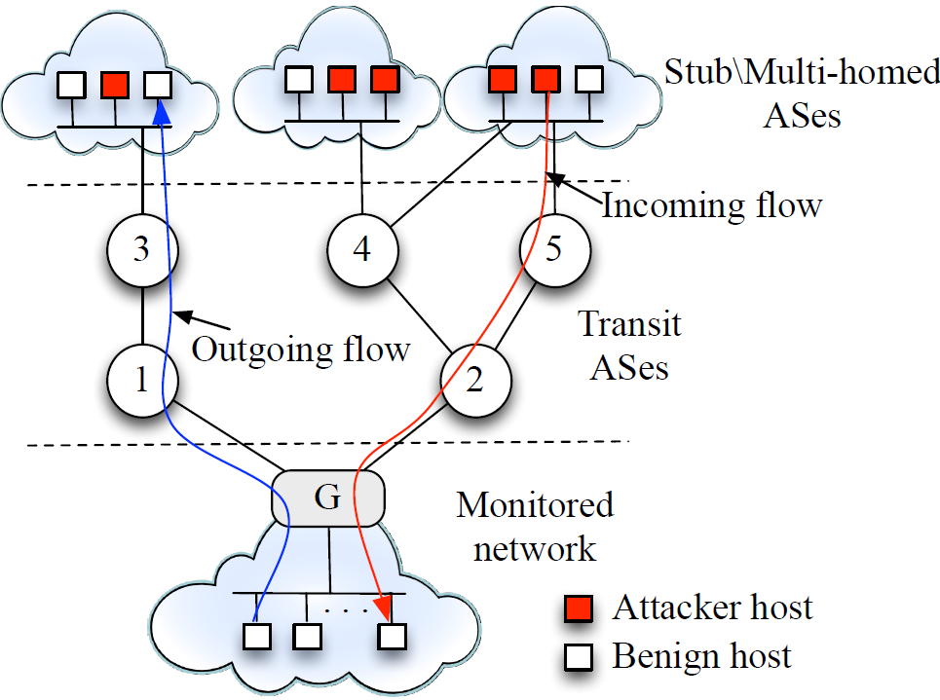
Using IMap for Monitoring Network Activity

Slide 40
Volumetric Analysis
[Johnson & Lazos, 2014]

Slide 41
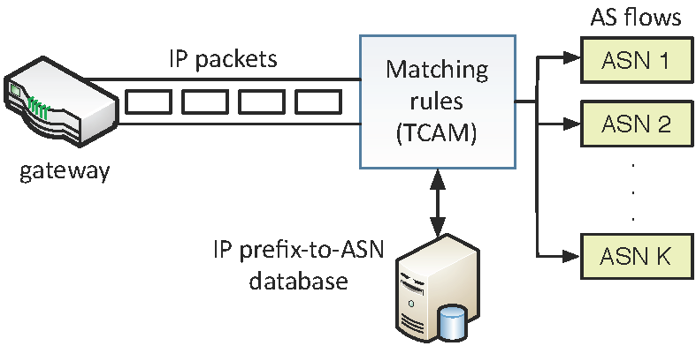
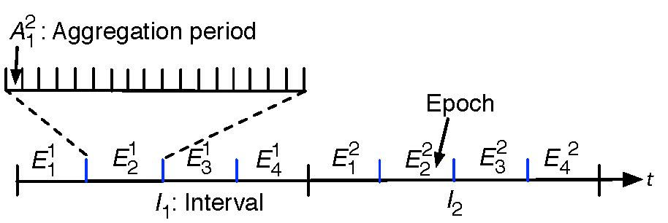
Step 1 – IP-to-AS Flow Translation
Aggregate IP flows to AS flows:
Each AS flow:
Number of IP flows
Number of IP packets
Volume (Bytes)

Slide 42
Step 2 – Heatmap Value Generation
Volume of traffic
Flows
Packets
X=
Real-time
data
X
D Heatmap values
Training data
pmf

Slide 43
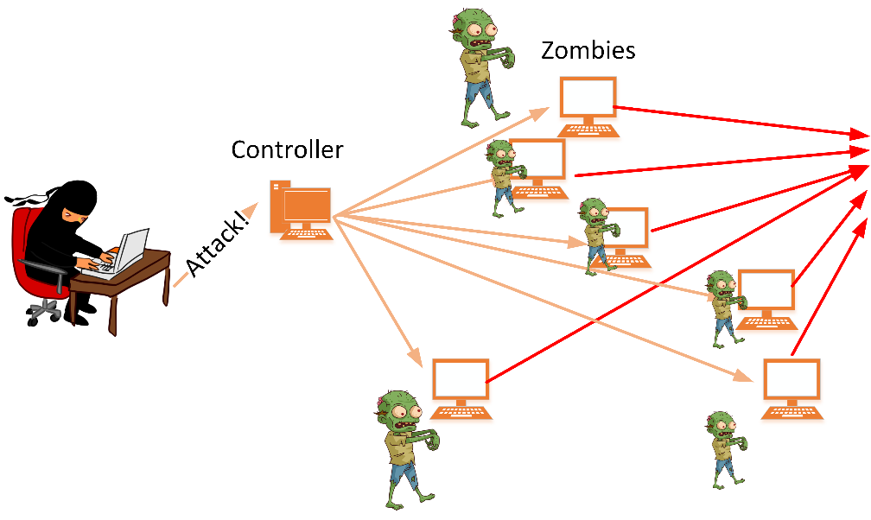
Synthetic DDoS Attacks
(VM) Background Traffic Generator
Up to 100 AS nodes
Ouch!
(VM) DDoS Traffic Generator
“Small” DDoS: up to 4 AS nodes
2. Botnet: 50k IP nodes
Target

Slide 44
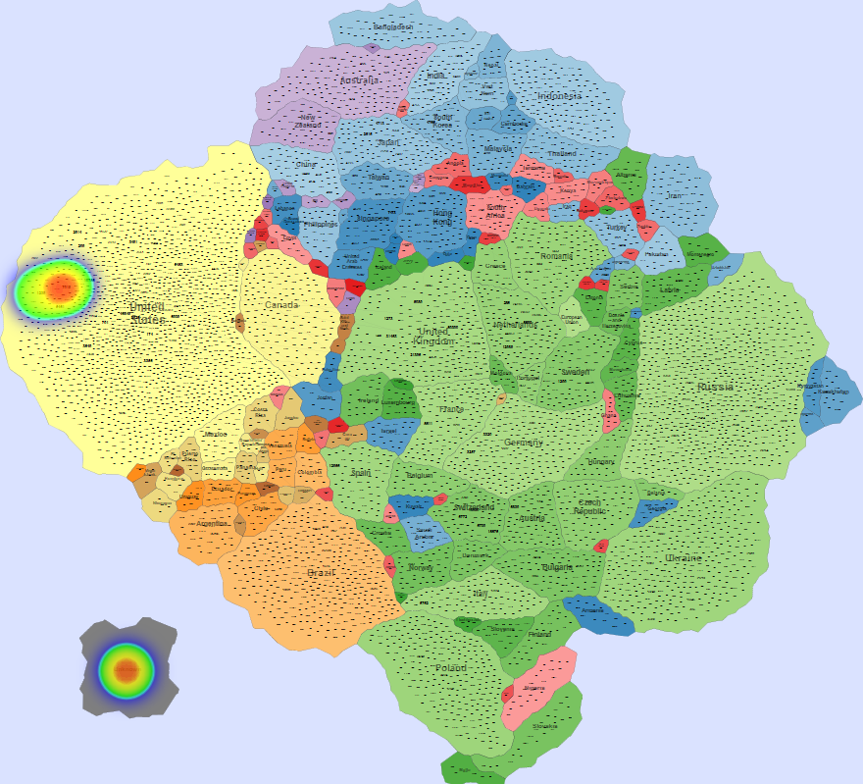
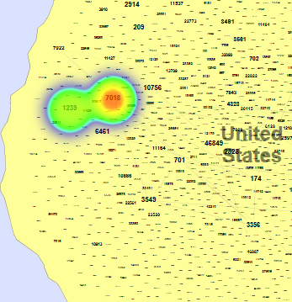
“Small” DDoS

Slide 45
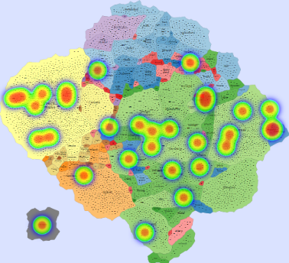
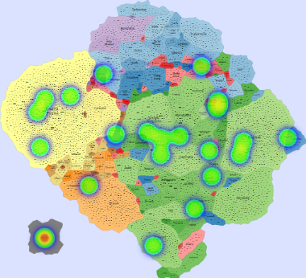
Botnet Attack
Time interval 1 Time interval 2

Slide 46
Further Considerations
Prediction of the impact of Outages on the topology by modifying the AS graph and looking at the resulting graph
Internet evolution—examine the Internet's evolutionary patterns
and predict future topologies
Enrich the topology view by including info on Internet Exchange Points and known physical connections (e.g., submarine cables)
Representation and analysis of Internet traffic flows at large scale (e.g., from CDNs)
By manipulating node and edge weights
By overlaying flow data as heatmaps

Slide 47
Further Considerations
Analysis of Internet relationships at the organization level
Provide multiple map views, optimizing the map-topology graph correspondence
area correlation, distance correlation, betweeness, modularity, etc.
Creation of new IMaps
Countries based upon organizations (e.g., Google, MS, Akamai, etc.)
Use “natural clustering” to form countries organically (no preset country constraints)

Slide 48
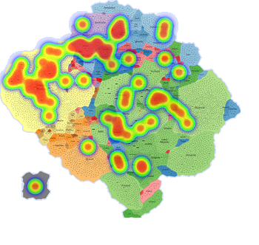
Thank you!
Project website:
http://vizsec-gama.cs.arizona.edu/

